Slide 1

Flight Price Prediction
Nikroshitha A Notani

Slide 2

Business Value
The flight ticket price is based on the demand and supply model with few estrictions on pricing from regulatory bodies.
It is often perceived as unpredictable and a recent dynamic pricing scheme added to the confusion.

Slide 3

Objective
My research focuses on predicting flight prices using advanced data analytics and machine learning.
The study aims to empower travelers with informed decision-making and assist airlines in optimizing pricing strategies for enhanced competitiveness.

Slide 4
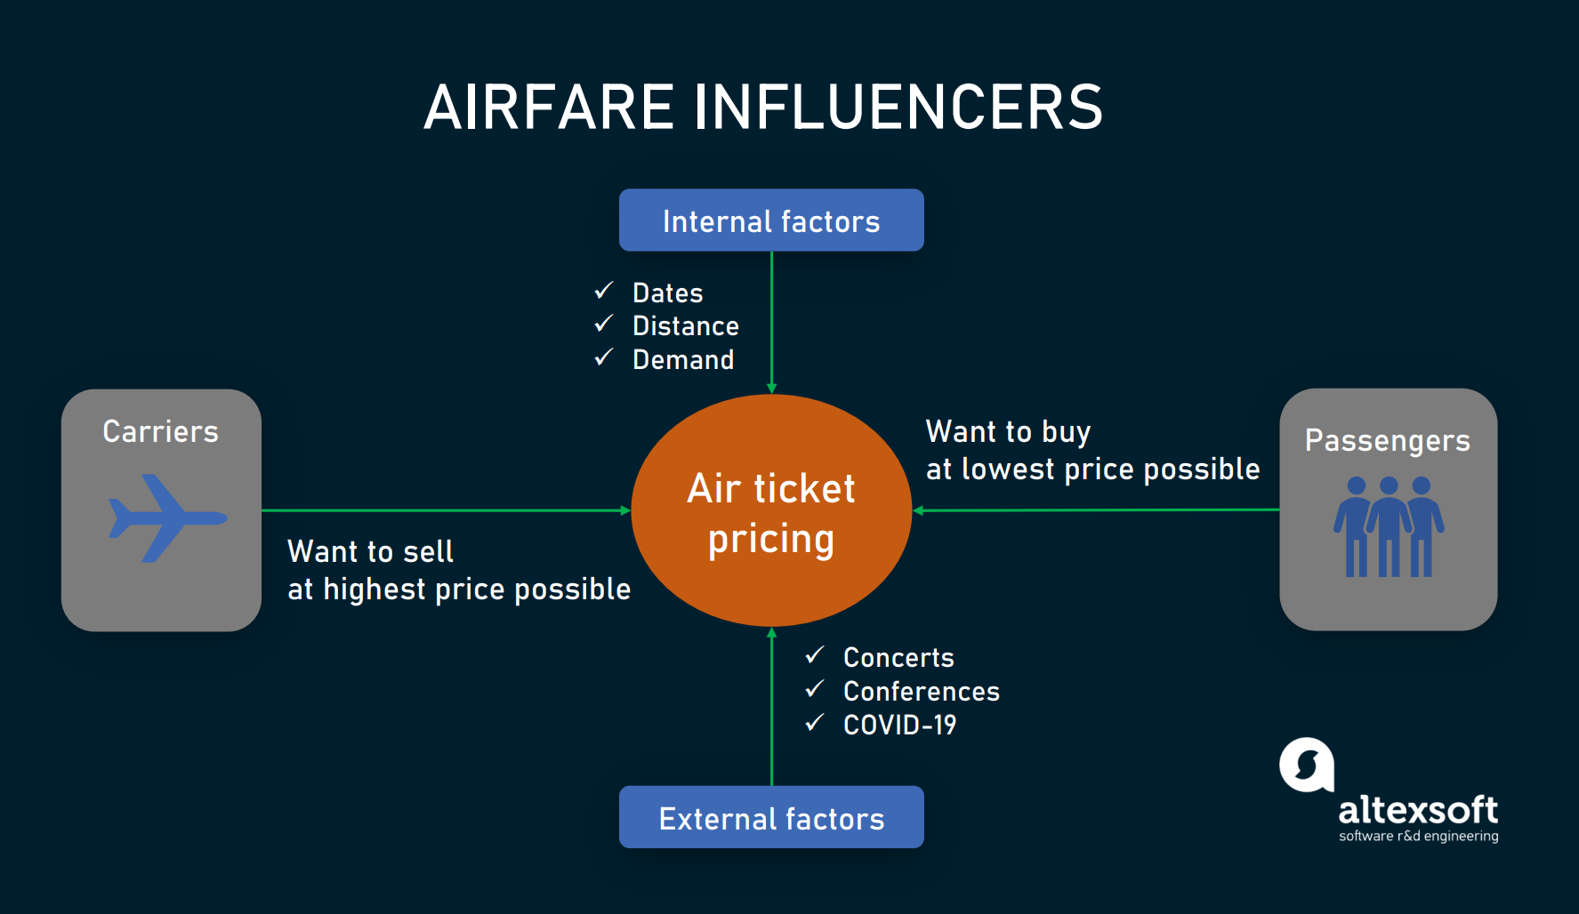

Slide 5
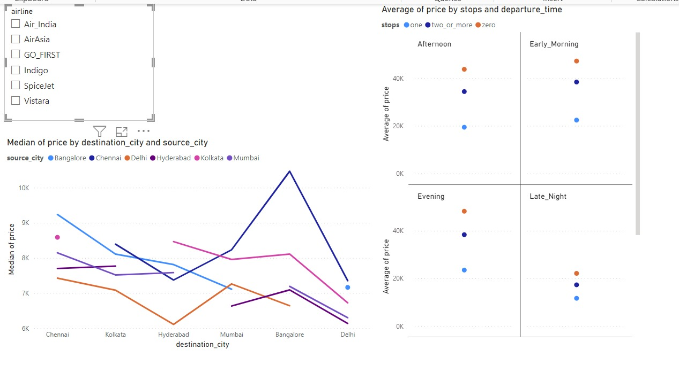

Slide 6
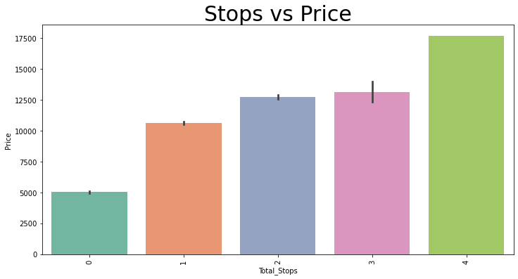

Slide 7
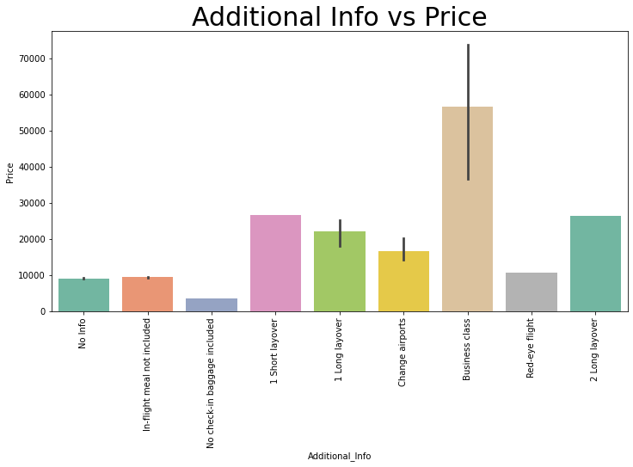

Slide 8
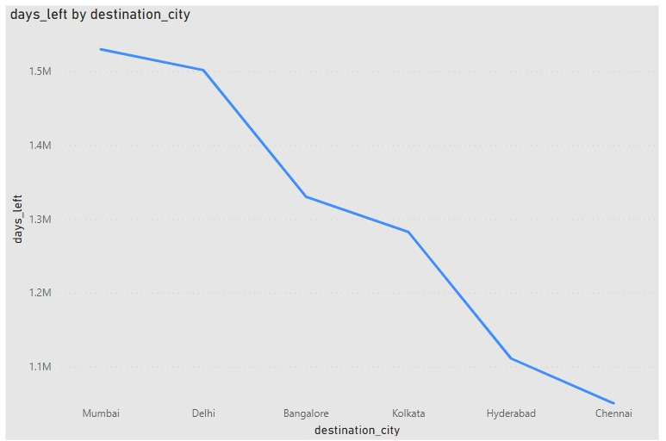

Slide 9
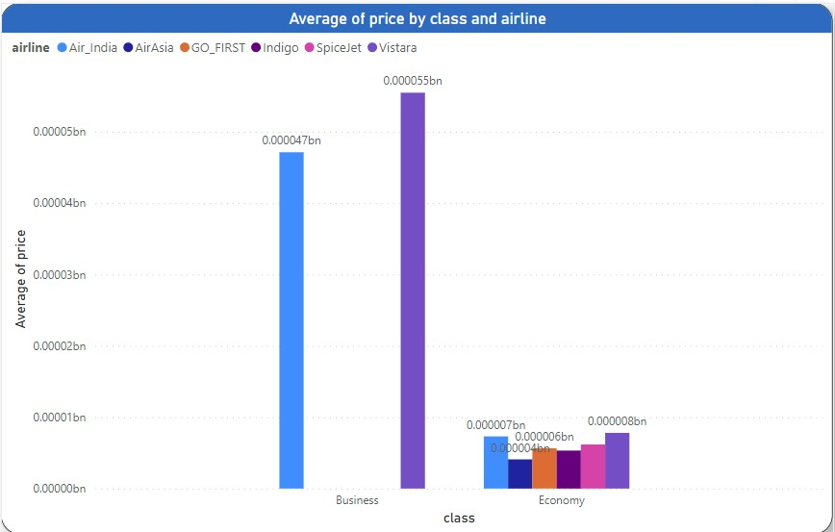

Slide 10
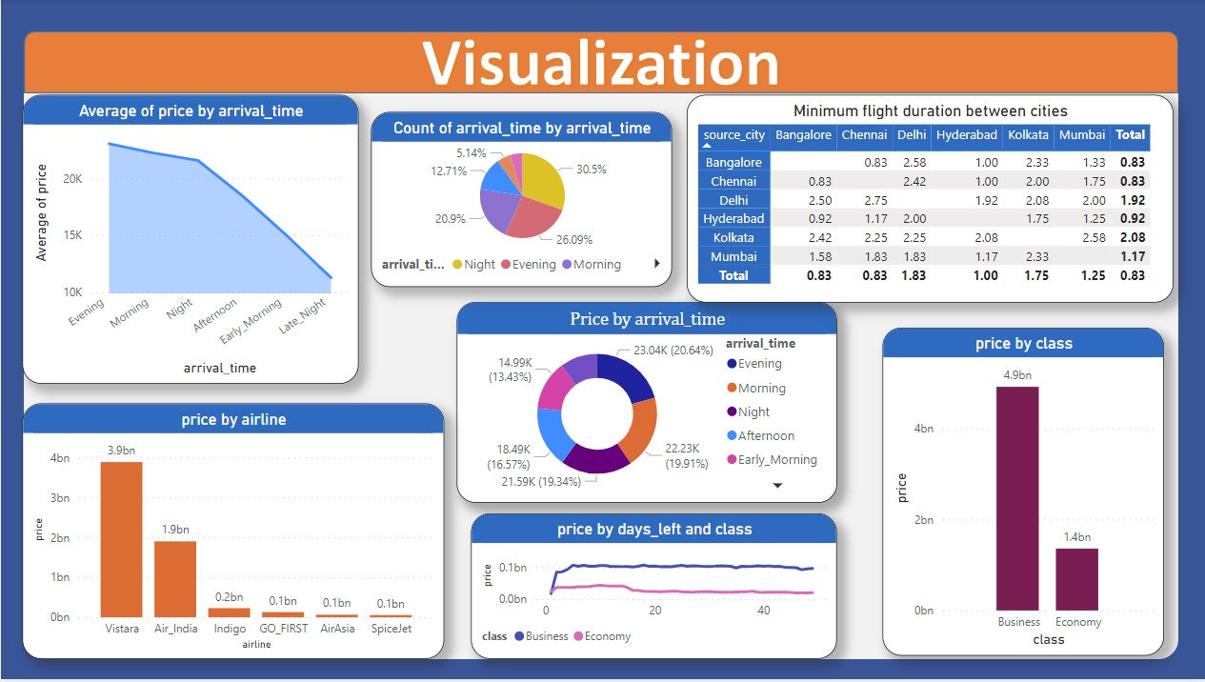

Slide 11
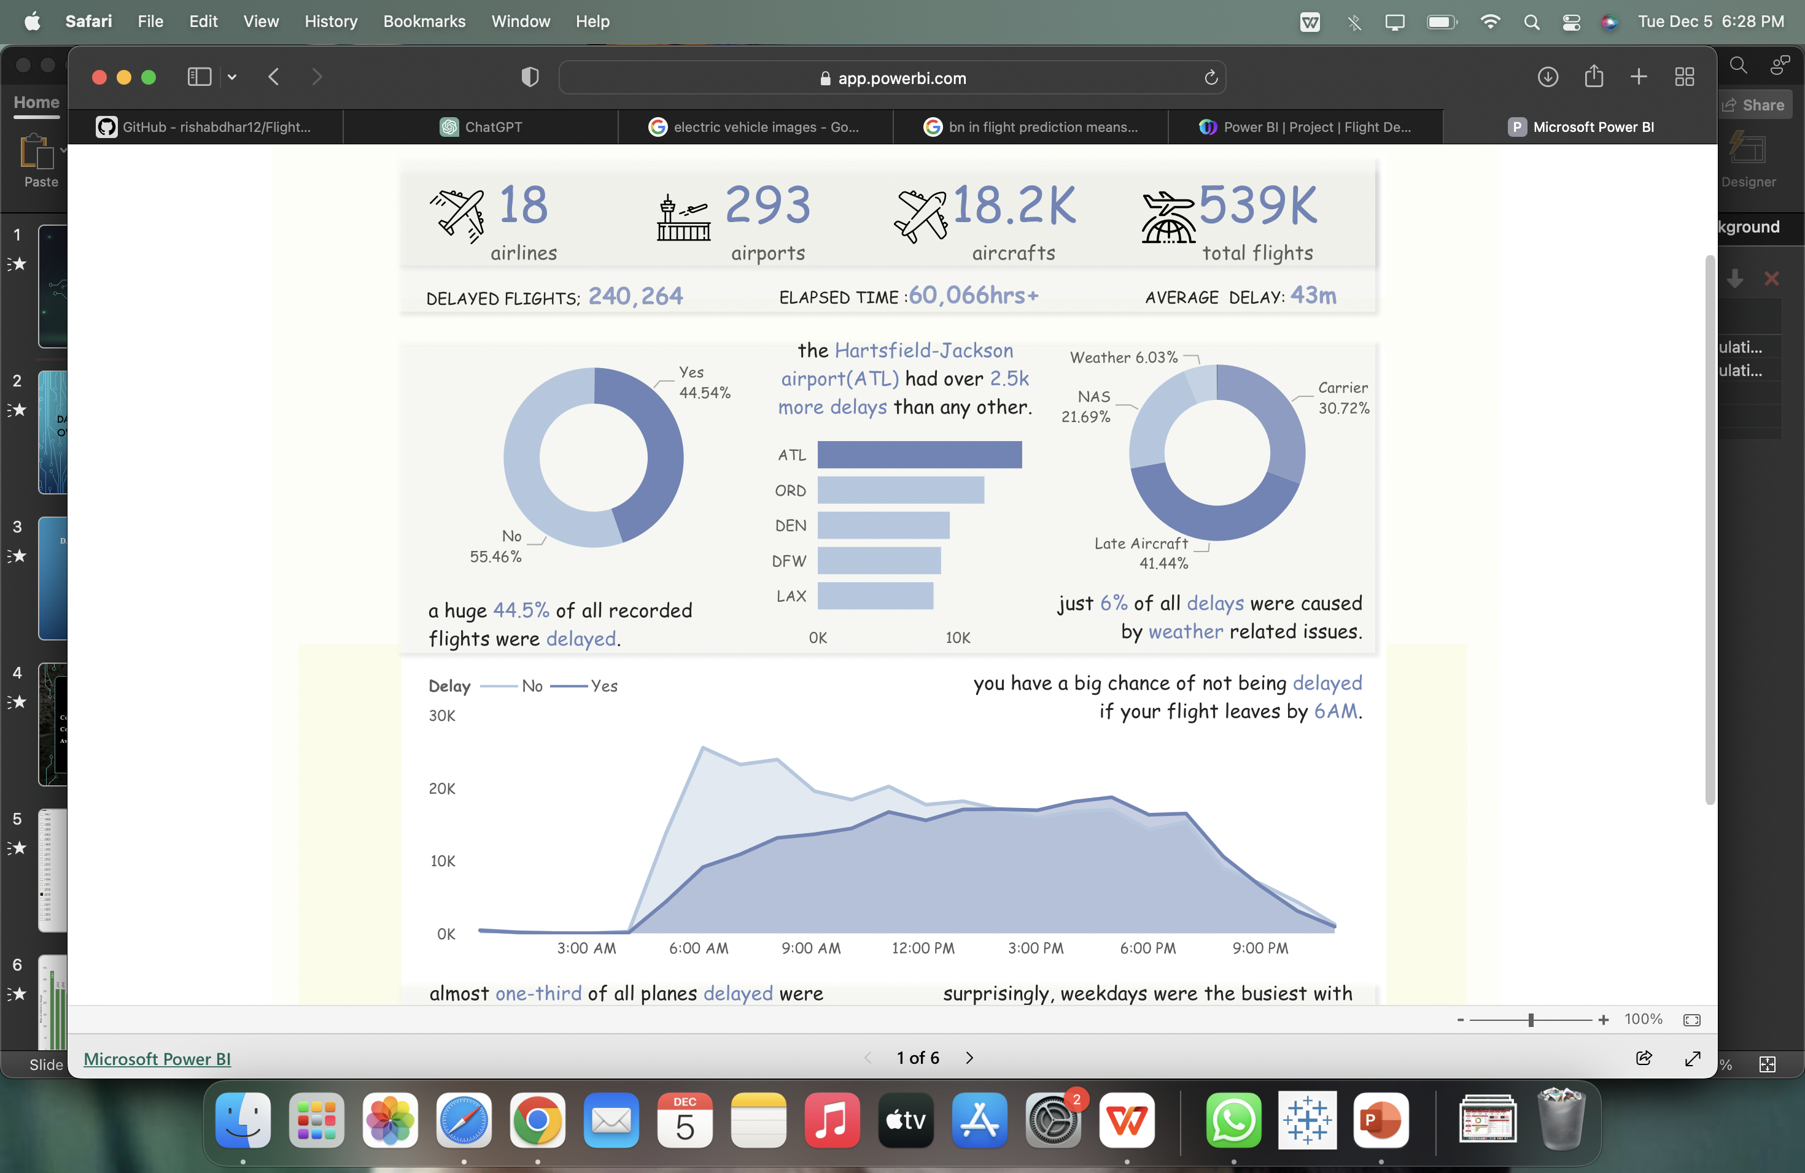

Slide 12

Conclusion
Users should be aware that predicting flight prices with complete certainty is challenging due to the dynamic nature of the aviation industry.
Always consider multiple sources and factors when planning and booking flights, and be aware that prices can change based on various unforeseen events.

Slide 13

Thank You

